Slide 1
CUSTOMER RELATIONSHIP MANAGEMENT SYSTEM

Slide 2
ABSTRACT
Customer relationship management (CRM) is a combination of people, processes and technology that seeks to understand a company's customers. It is an integrated approach to managing relationships by focusing on customer retention and relationship development. CRM has evolved from advances in information technology and organizational changes in customer?centric processes. Companies that successfully implement CRM will reap the rewards in customer loyalty and long run profitability. However, successful implementation is elusive to many companies, mostly because they do not understand that CRM requires company?wide, cross?functional, customer?focused business process re?engineering. Although a large portion of CRM is technology, viewing CRM as a technology?only solution is likely to fail. Managing a successful CRM implementation requires an integrated and balanced approach to technology, process, and people.

Slide 3
INTRODUCTION
CRM is a strategy and technology that is used to build stronger relationships between organizations and their clients. An organization will store information that is related to their clients, and employees will analyze it to use it in forecasting and making reports. Some of the strategies of CRM software are planning for targeted marketing campaigns towards specific clients. The strategies used will be relying on the information that is coming from the CRM system. CRM software solution is commonly used by all kind of corporations that focusing on maintaining a strong relationship with their customers.
There are many reasons why CRM software has become the most important software in the last 10 years. The competition has become highly competitive in the global market, and it has become easier for clients to switch companies if they are not happy with the service they receive or want the product with the low price. One of the primary goals of CRM solution is to retain clients and protect them from competitor’s temptations. When CRM is used effectively, an organization will be able to build a relationship with their clients that can last a lifetime. It is so important to realize that CRM system solution is more than just software.
This CRM introduction aims to explaining what the CRM is in a nutshell and making it easier to realize the tremendous benefits of purchasing a Customer Relationship Management software that will help drive more customers thus more profit towards you and makes your life easier.

Slide 4
HARDWARE SPECFICATION
Processor : P 4 700 GHz.
RAM : 4 GB RAM
Hard Disk Drive : 180 GB

Slide 5
SOFTWARE SPECIFICATION
Operating System : Windows 7/8/10
Front End : JAVA
Back End : SQL

Slide 6
EXISTING SYSTEM
There are not any existing system for clide side. SO all the work are handle manually and have to be noted down in some register and also taking care of that documentation. They are arranged meeting by call and if any update occured then again call the client and update meeting schedule, its wasting time and as well as money also and also the disturb the valuable clients.

Slide 7
PROPOSED SYSTEM
The focus of customer relation ship management is on creating value for the customer and the company over the longer term. when the customers value the customer service that they receive from suppliers, they are less likely to look to alternative suppliers for their needs and CRM enables organization to gain competitive advantage over competitors that supply similar products or services.

Slide 8
Types of modules
1. sales manager
2. Sales people
3. Create/Manage Task
4. Create/Manage Leads
5.Task Report

Slide 9
Modules
Sales Manager
A Sales manager using the web page to login into their activity. In login page the manager select the sales manager radio button and enter the login credential to access this application. without credential they cannot access this application.
Sales People
A Sales peolple also use the same page to access this login page, but instead of selecting the sales manager option they should choose the sales people option to use the login page. A sales people use the valid credential to cross the login page otherwise it will shown an error which does not allow to access this application.

Slide 10
Create / Manage Task
Both user can create the task but only the sales manager can have an access to manage the task details. When the user wants to remove or update the ticket details they can have an access to thease details. Once the task has been created it will be assiged to the sales people.
Create / Manage Leads
Sales manager can create and manage the lead deatils, every details will be stored in a database tables. once the details are stored then can modify the details.
Task Report
Finally can view the details of the task report, which could to be generate overall performance and task status whether they have completed or not. Also whenever they want to download or print the report which could be possible.

Slide 11
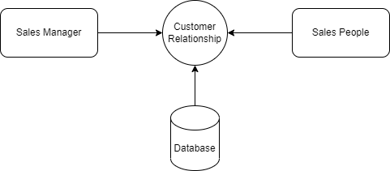
Data Flow Diagram
Level 0:

Slide 12
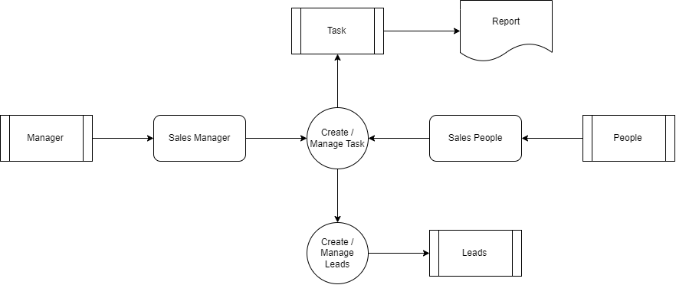
Level 1:

Slide 13
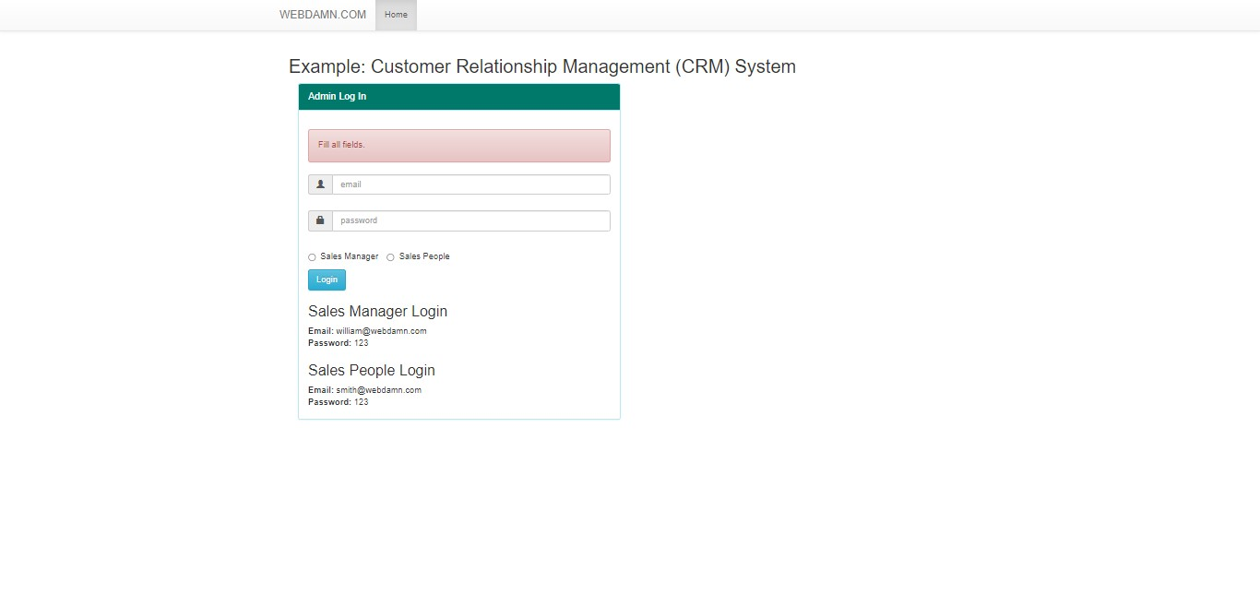

Slide 14
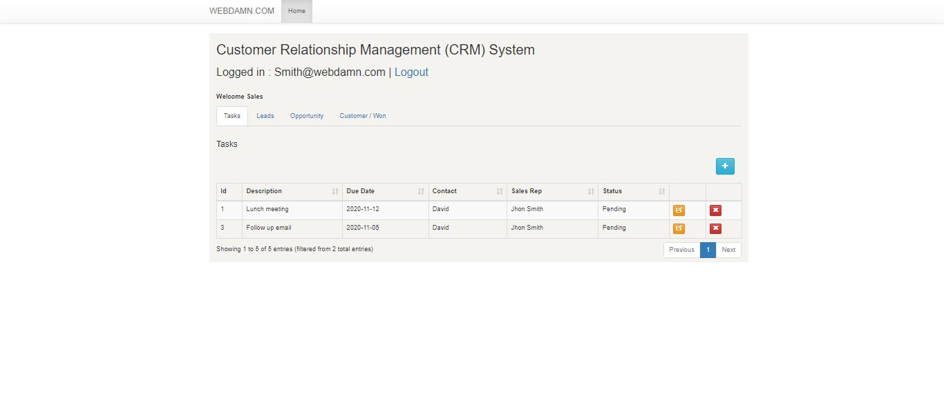

Slide 15
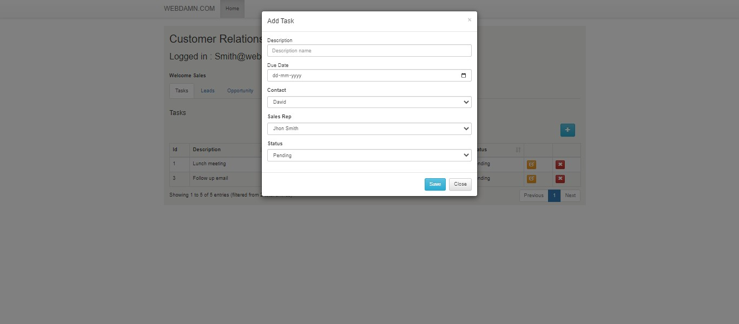

Slide 16
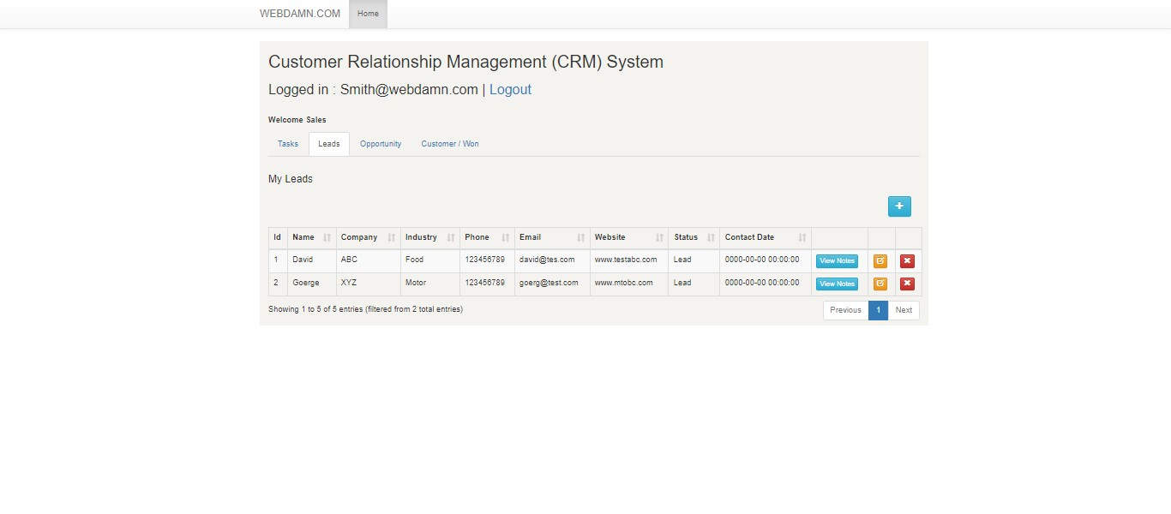

Slide 17
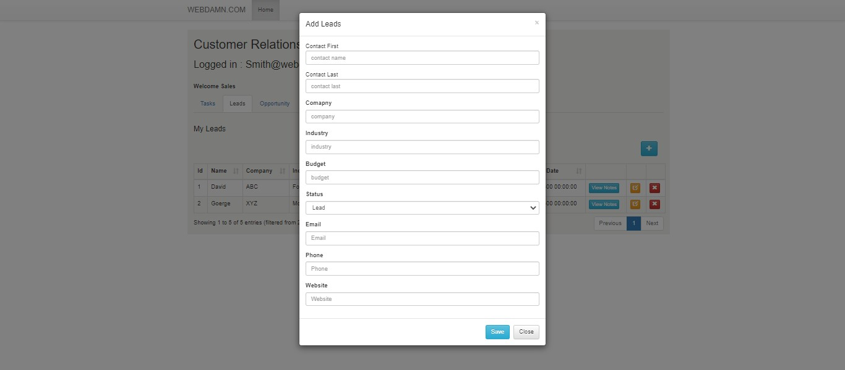

Slide 18
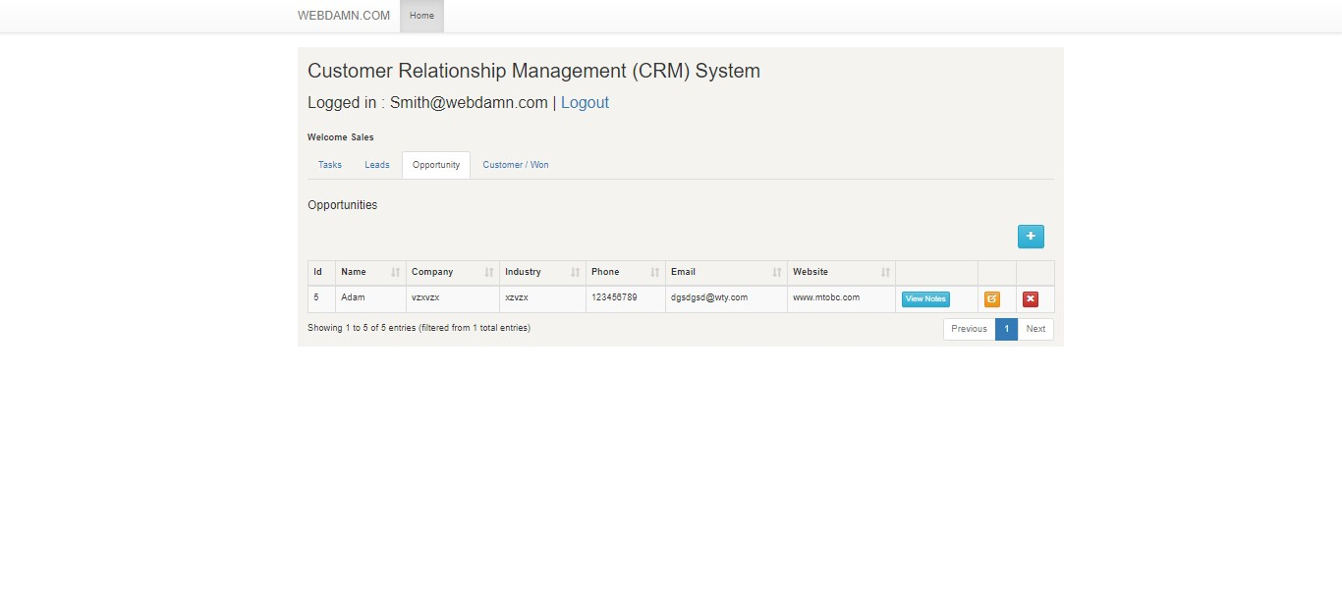

Slide 19
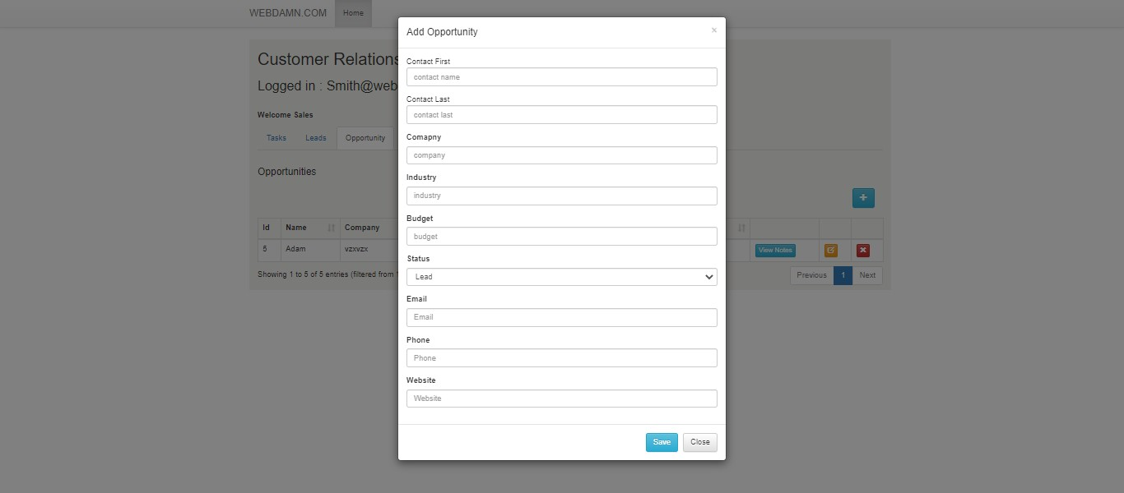

Slide 20
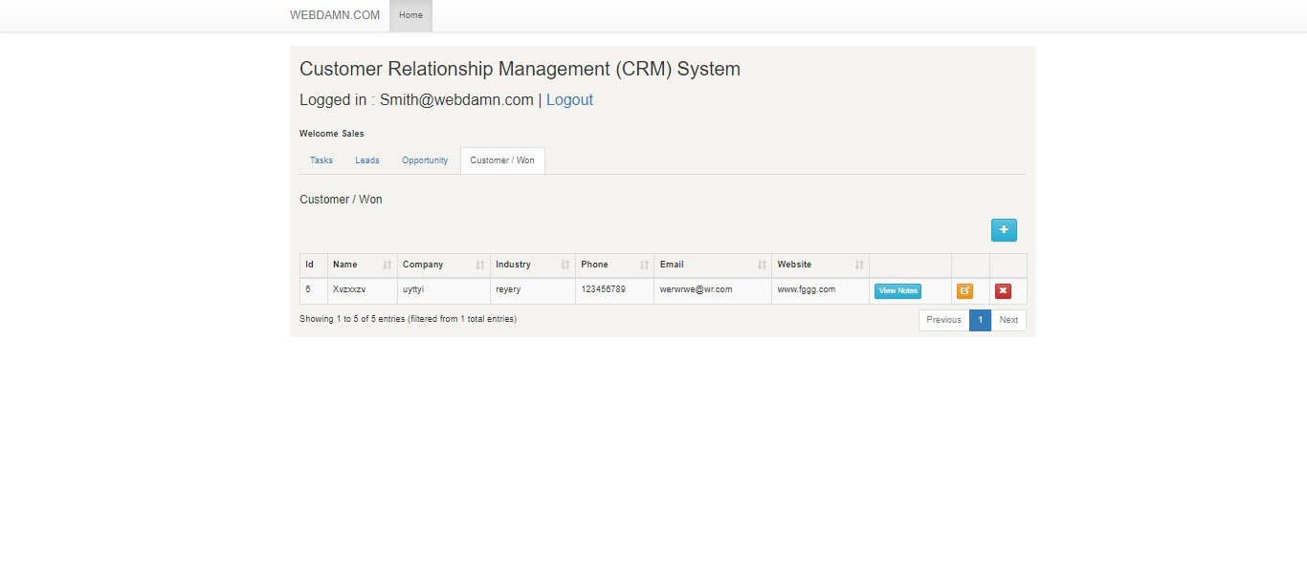

Slide 21
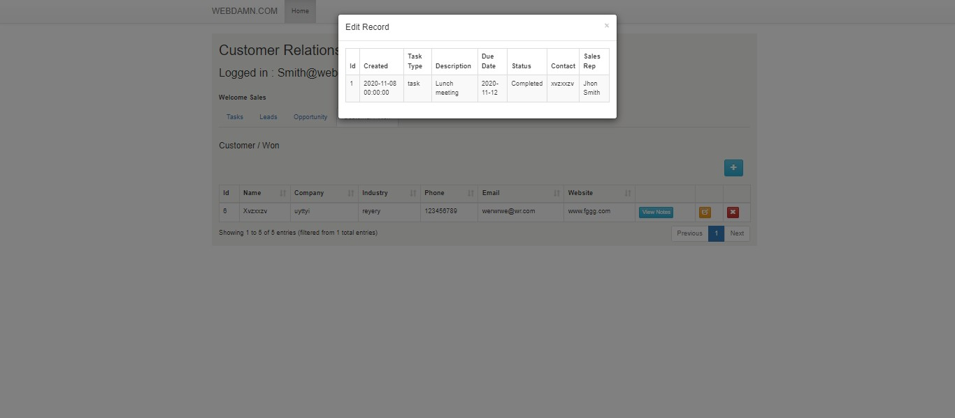

Slide 22
Thank You

